Slide 1
Progress Report (24th Week)
Presented by wmr
17/07/2020

Slide 2
A Systematic Study of Unsupervised Domain Adaptation for Robust Human-Activity Recognition
Youngjae Chang, Akhil Mathur, Anton Isopoussu, Junehwa Song and Fahim Kawsar
KAIST, South Korea
Nokia Bell Labs, United Kingdom
[The Proceedings of the ACM on Interactive, Mobile, Wearable and Ubiquitous Technologies (IMWUT) 2020]
Notes:
韩国科学技术学院

Slide 3
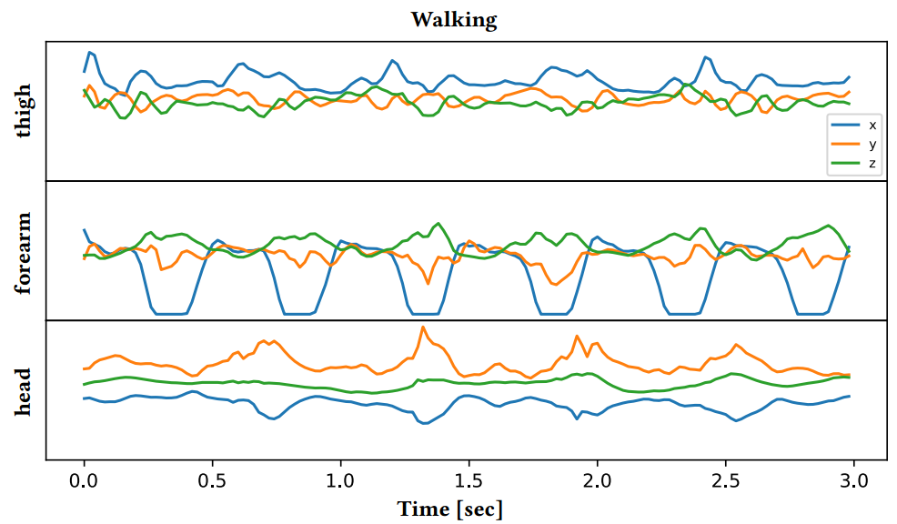
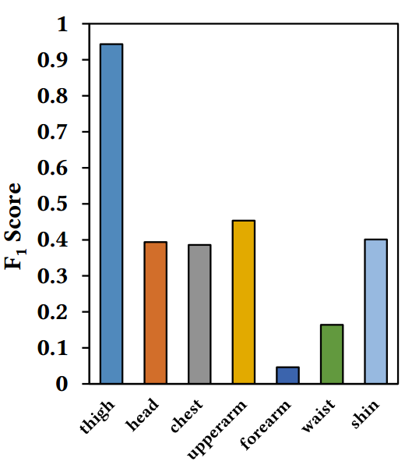
Motivation
Wearing Diversity in wearable device-based Human Activity Recognition (HAR)

Slide 4
Related Work
Enhancing robustness of HAR on wearing diversity
Unsupervised Domain Adaptation (UDA)
Strategy | Work | Method | Drawback
Body-position-aware model | [1] | SVM, HMM | focus on a limited number of body positions and activities
 | [2] | A pipelining approach
 | Sztyler[3] | Extension of [2] | not scalable
Body-position-independent model | [4,5] | Decision tree and kernel function | limited in the number of body positions and activities
 | [6] | Selects eﬀective features for each body position | hard to be applied to deep learning models where features are learned from the data
 | [7] | DNN | high cost of data collection
Work | Method | Difference
HDCNN[8] | Feature matching to reduce the discrepancy between two datasets | build a new model hat will only perform on a new wearable sensor attached to a specific body position
MotionTransformer[9] | Confusion maximization
[10] | Variational autoencoder and feature matching
This paper | build models that work robustly on multiple body positions comparison of adaptation techniques

Slide 5
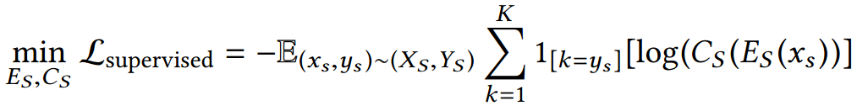
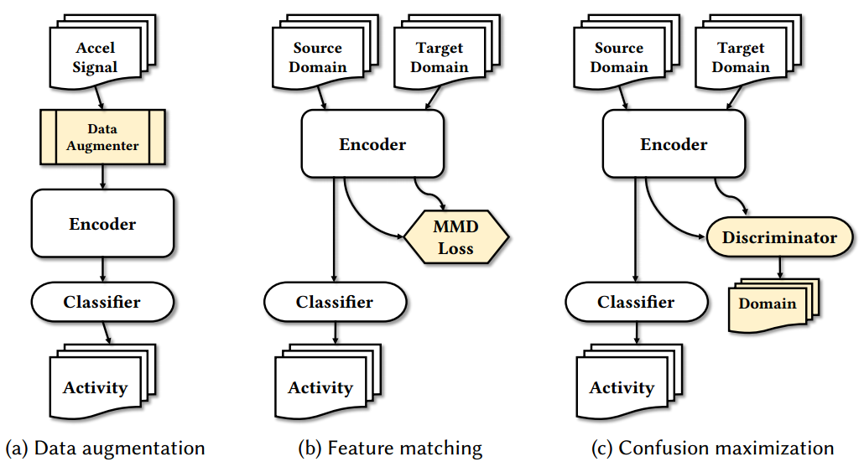
UDA Techniques
number of activity classes
feature encoder
classifier
Input, labels

Slide 6
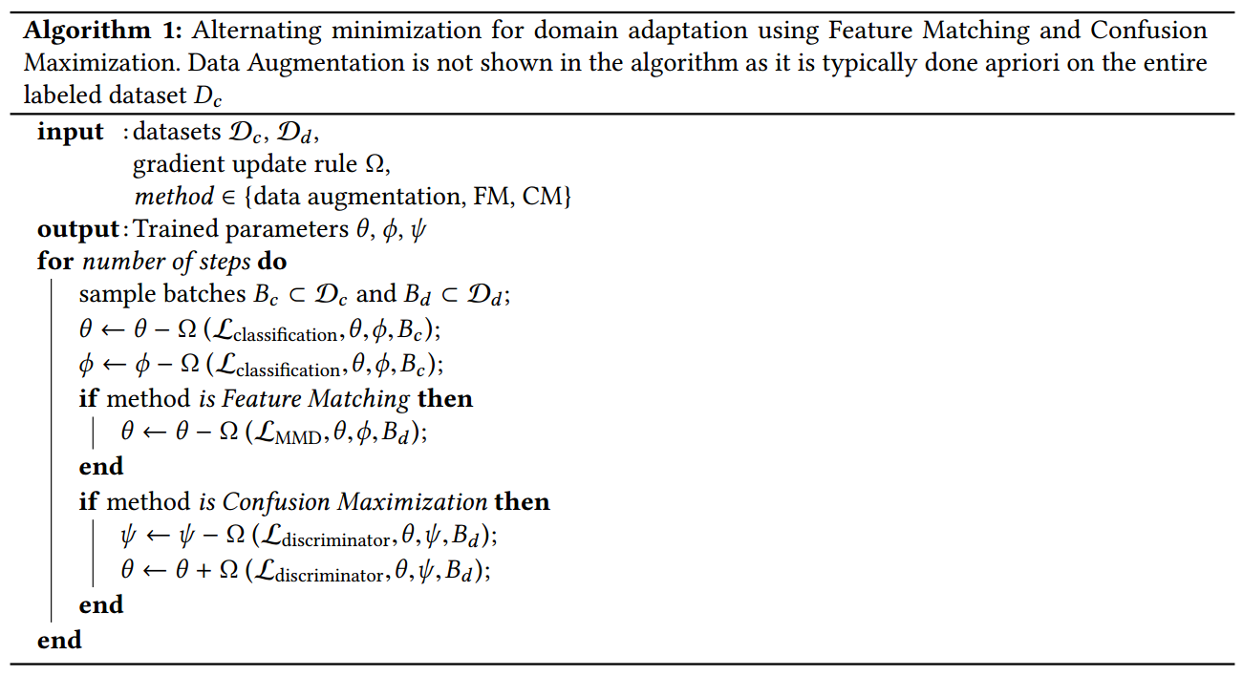
Model Training Process
Alternating minimizing the classification error and maximizing invariance of features
labeled
unlabeled
train parameter θ for encoder
train parameter ϕ for classifier
minimize MMD
optimizing the loss of discriminator
backpropagate this loss

Slide 7
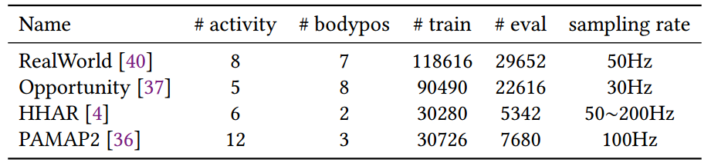
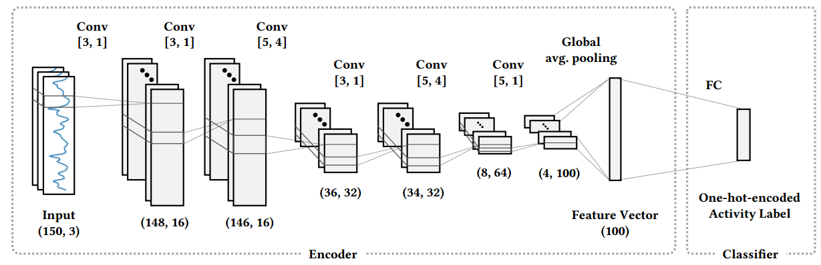
Experiment Setup
Dataset
Model architecture
[kernel size, stride]
size of output vectors

Slide 8
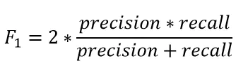
Evaluation Metrics
Key metrics
Adaptability refers to the performance on target body positions supplied as an unlabeled dataset
Persistence measures the performance on source domain, after it undergoes the domain adaptation process
Generalizability measures how well a model performs on body positions for which it was neither trained nor adapted
Macro-averaged F1 score

Slide 9
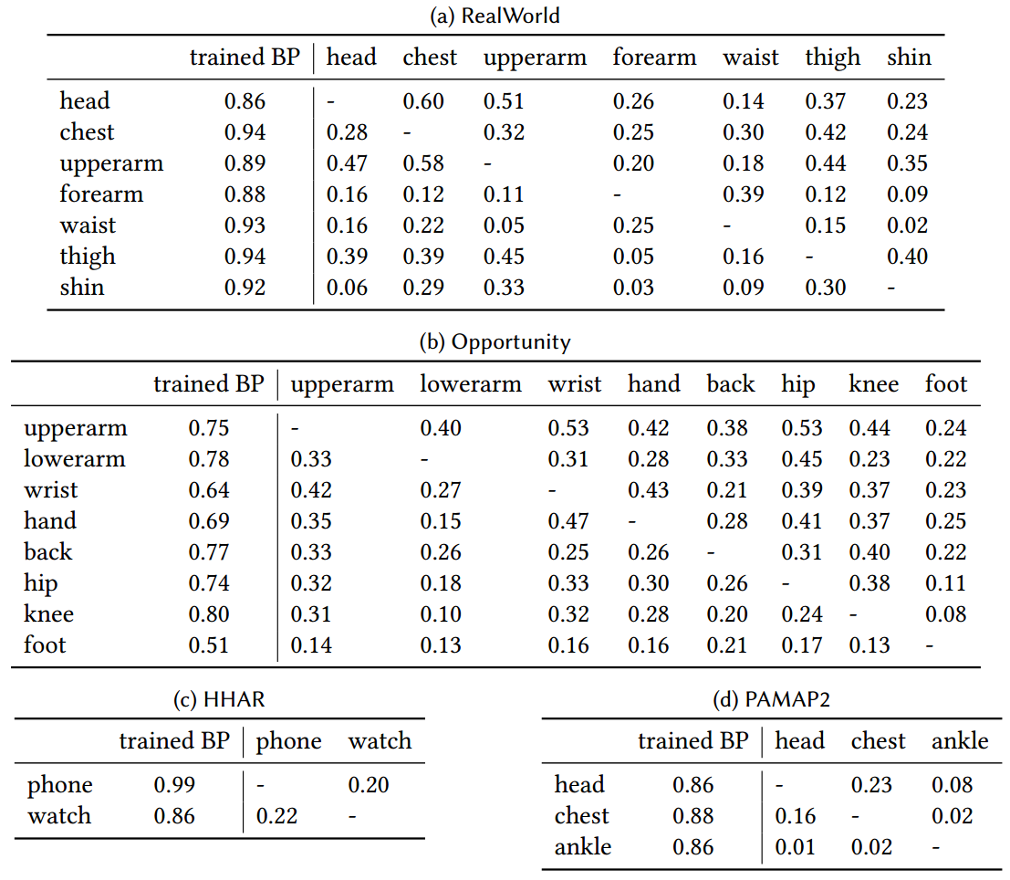
Evaluation Results
Baseline

Slide 10
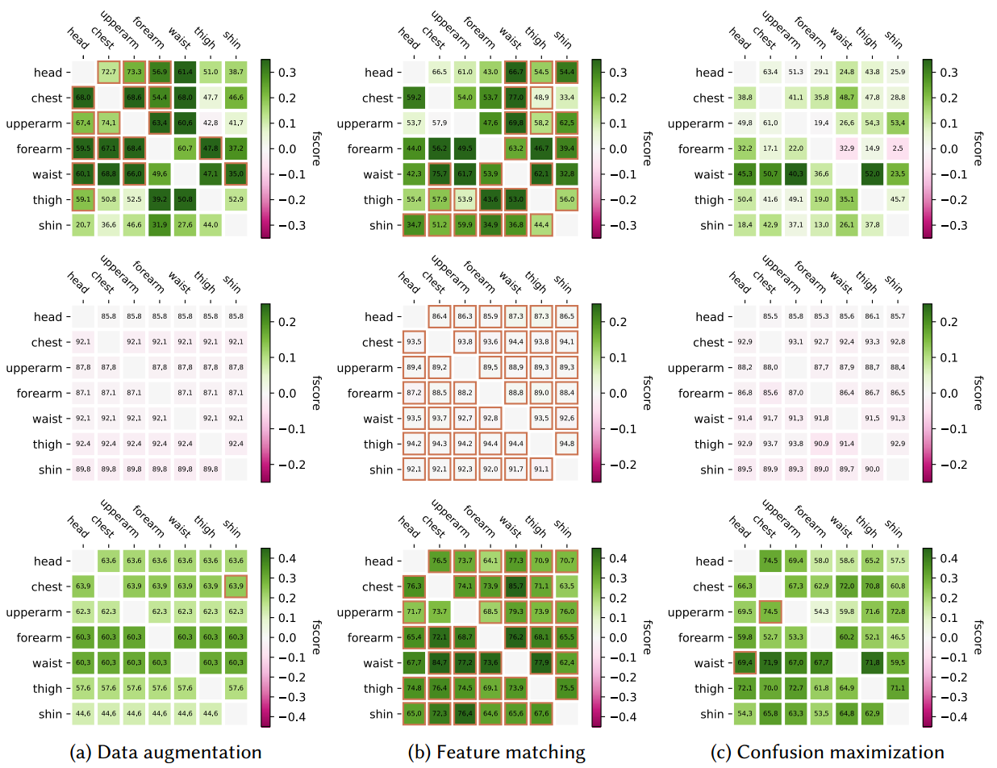
Evaluation Results
unlabeled
Adaptability
labeled
Persistence
Generalizability

Slide 11
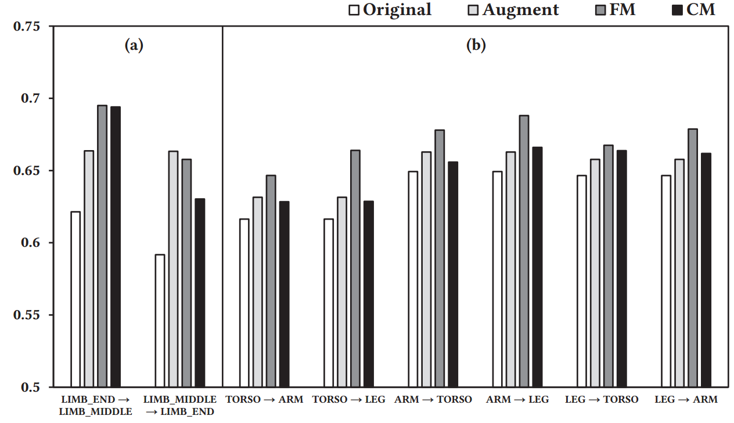
Evaluation
F1 score on all body positions (generalization)

Slide 12
Inspiration
Wearable diversity is also affected by different users and their habits
Confusion maximization can not guarantee good persistence

Slide 13
Thanks!

